Slide 1


SUSTAINABLE DEVELOPMENT GOALS

Slide 2
INTRODUCTION
The 70th United Nations General Assembly has adopted 17 Sustainable Development Goals (SDGs), with 169 targets and 304 indicators, on 25th September, 2015 under the official agenda “Transforming our world: the 2030 Agenda for Sustainable Development”.
India is a signatory to this landmark agreement, which set forth a set of 17 goals, to be achieved by 2030.

Slide 3
SDGs Implementation Framework in India
NITI Aayog is the Nodal Agency in India which undertakes mapping of SDG Goals and Targets with Schemes, identification of Nodal Ministries and Government Departments for each of the Goals and Targets.
At the State level, Planning Departments are the Nodal Department for implementation of SDGs in each State.
In Mizoram, Planning & Programme Implementation Department is the Nodal Department for implementation of SDGs.

Slide 4
The following committees and cell has been constituted to coordinate SDGs implementation in the State:
1. High Level Monitoring Committee:
The Committee is set up under the Chairmanship of Chief Secretary, Government of Mizoram with Planning Secretary as Member Secretary.
2. Technical Committee on SDGs:
The Committee is formed under the Chairmanship of Director, Economics & Statistics Department where all Nodal Officers of Line Departments are members.
3. SDGs Cell:
A dedicated SDGs Cell has been established in Research & Development Branch of Planning & Programme Implementation Department headed by the Principal Adviser.

Slide 5
Actions taken towards SDG implementation in Mizoram
Action taken towards SDG Implementation in Mizoram
Baseline Survey
Mizoram Vision 2030
Regional Workshop
State Level Sensitization Workshop
District Level Sensitization Workshop
Wall hanging
Video clips on SDGs
Talk show
Mizoram SDG Website

Slide 6
Partnership for implementation of SDGs in Mizoram
At the international level, UNDP has been an active partner in technical matters. Several discussions have been held with UNDP at Aizawl and Guwahati. Formal Memorandum of Understanding is expected to be sign shortly.
At the institutional level, we have been partnering with Mizoram University, ICFAI University Mizoram, Administrative Training Institute (ATI) and State Institute of Rural Development and Panchayati Raj (SIRD&PR) for technical issues.
At the district and local levels District Planning Committee is the monitoring body at district and village level for implementation of SDGs. Local channels, colleges and schools are our active partners in spreading awareness and sensitization programmes.

Slide 7
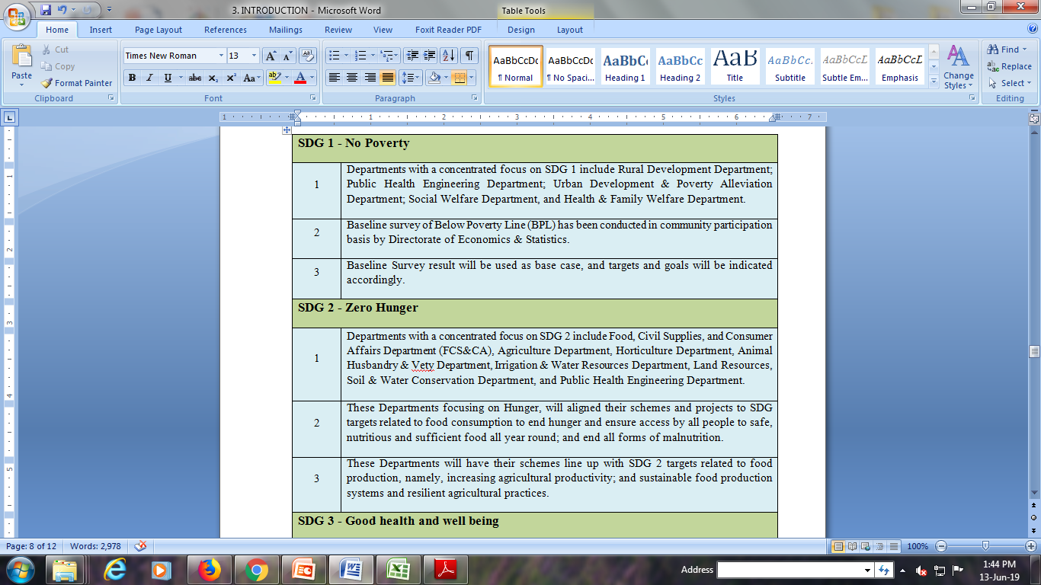
Landscape analysis of SDGs Implementation in Mizoram

Slide 8
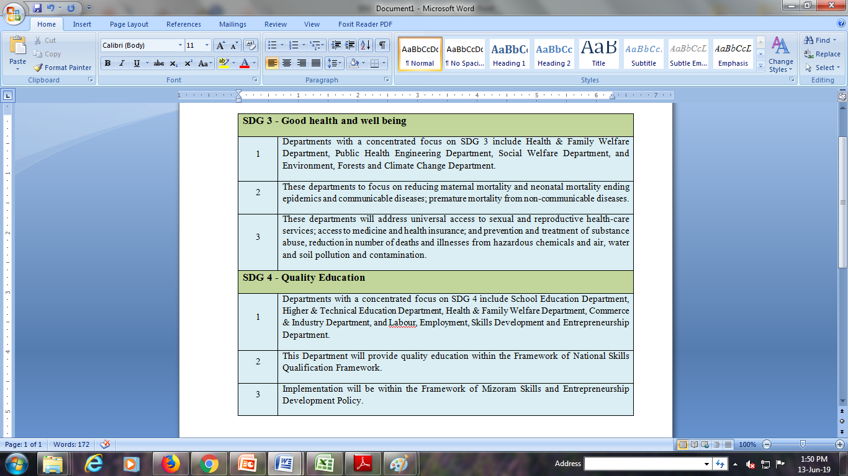

Slide 9
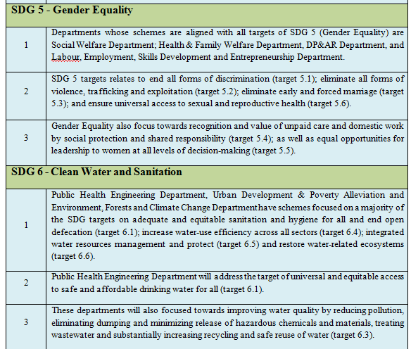

Slide 10
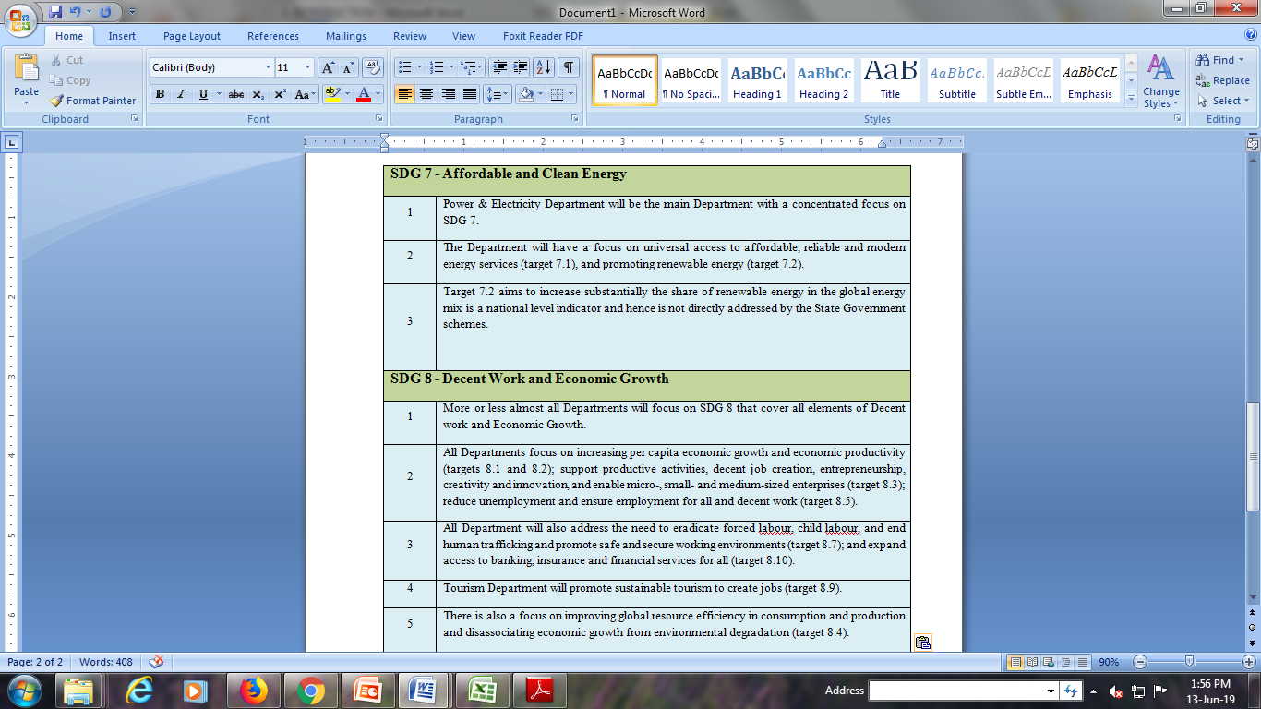

Slide 11
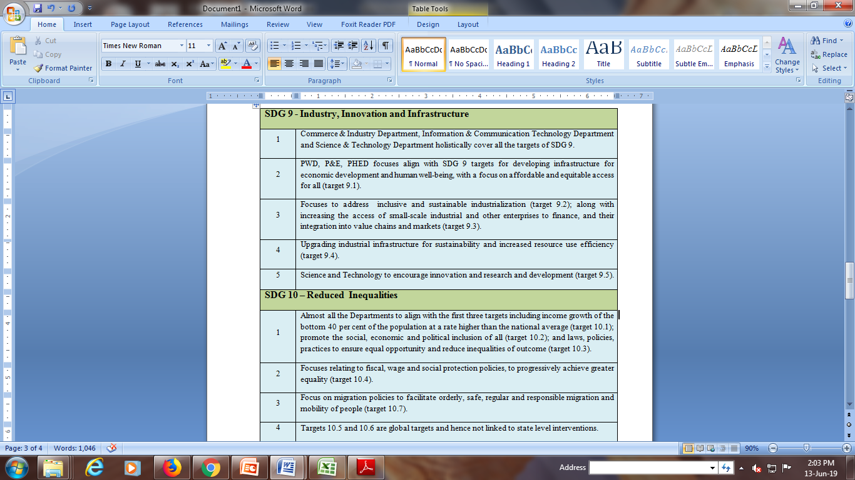

Slide 12
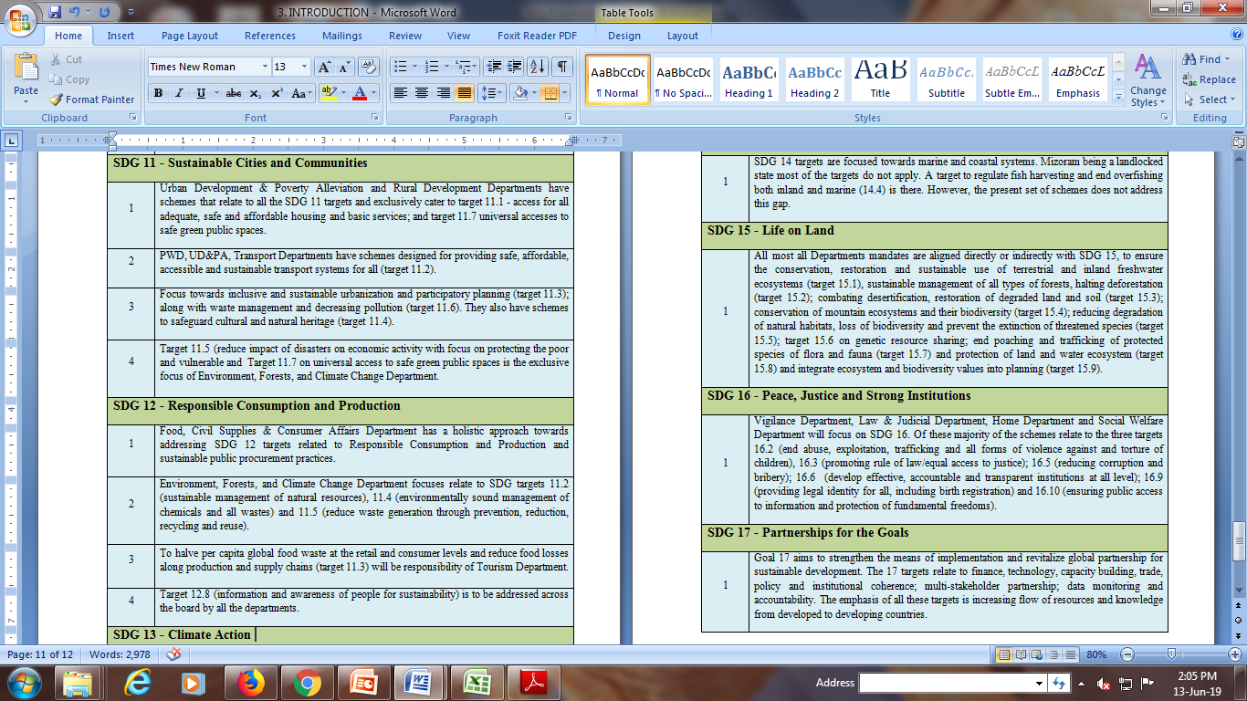

Slide 13
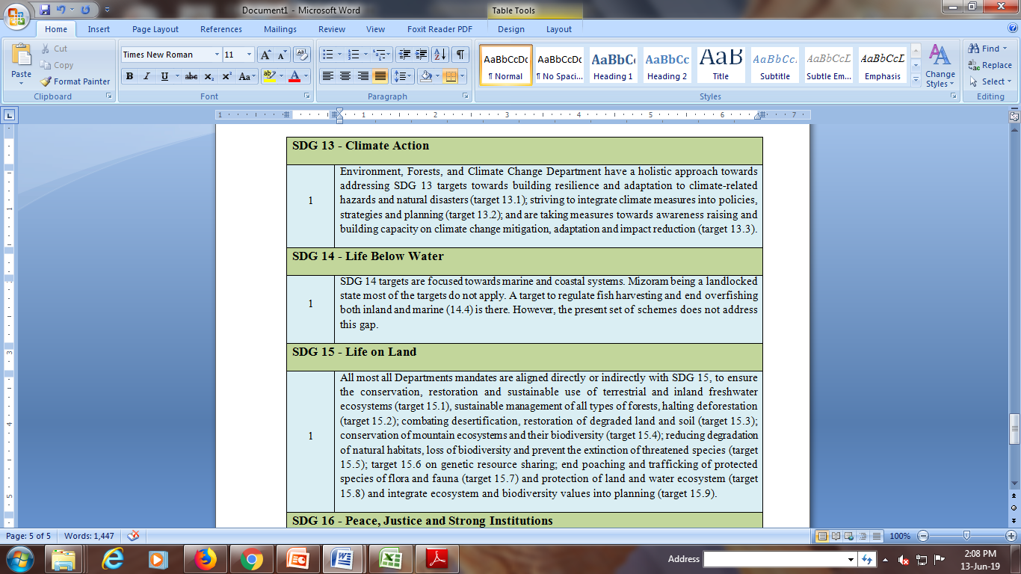

Slide 14
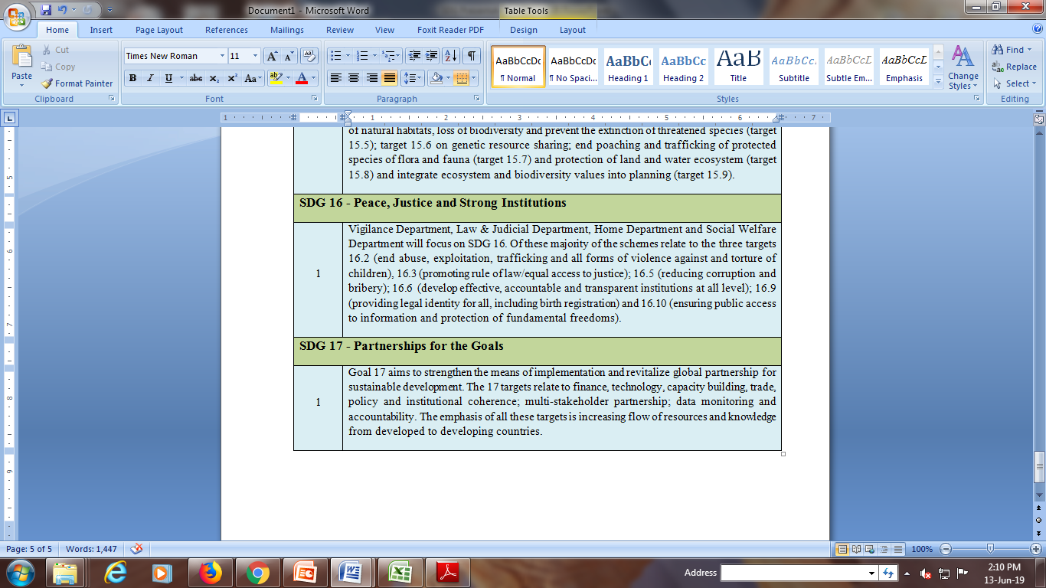

Slide 15
SDGs Dashboard Format For Data Collection and Monitoring
Example: Goal No. 1 : – Goal, Indicator, Base-case and Target
Sl.No | Goals | Target | Priority Indicator | Data Source | Intervention/Schemes | Department | Schematic Indicators | Baseline Data (Preferably 2015-2016) |  | Target
 |  |  |  |  |  |  |  | Reference Period | Data Report | 2019-2020 | 2024-2025 | 2029-2030
1 | SDG 1 : No Poverty | By 2030, eradicate extreme poverty for all people everywhere | Proportion of population living below the poverty line | BPL Survey | Targeted PDS | FCS & CA | %age of AAY HH covered under TPDS | 2015-16 | 9.77% | 7.45% | 3.65% | 1.61%

Slide 16
Illustration of Goals, Indicators, Baseline Data &Targets
Goals | Schematic Indicators | Baseline Data |  | Targets
 |  | Reference Period | Data Report | 2019-20 | 2024-25 | 2029-30
Goal 1: No Poverty | %age of BPL HH | 2015-16 | 19.63 | 14 | 9 | 3
Goal 2 : Zero Hunger | %age of AAY HH covered under TPDS | 2015-16 | 9.77% | 5.50% | 3.06% | 1.61%
Goal 3: Good Health and Wellbeing | Annual Malarial Death | 2015-16 | 21 | < 10 | < 5 | < 1
Goal 4: Quality Education | Drop Out Rate at Primary level | 2016-17 | 15.4 | 10 | 5 | 0
Goal 5 : Gender Equality | No. of Domestic Violence Cases | 2016-17 | 115 | 80 | 60 | 20

Slide 17
Goals | Schematic Indicators | Baseline Data |  | Targets
 |  | Reference Period | Data Report | 2019-20 | 2024-25 | 2029-30
Goal 6: Clean Water and Sanitation | %age of households covered by IHHL (rural) | 2015-16 | 100% | 100% | 100% | 100%
Goal 7 : Affordable and Clean Energy | %age share of Renewable energy in the total final energy mix | 2015-16 | 14.19% | 25.25% | 32.00% | 40%
Goal 8: Decent Work and Economic Growth | No. of beneficiaries under Stand up India | 2015-16 | 0 | 40 | 100 | 200
Goal 9: Industry, Innovation and Infrastructure | No. of Registered MSME Unit174 | 2015-16 | 174 | 370 | 600 | 860
Goal 10 : Reduced Inequalities | Growth rates of household expenditure per capita | Data Not Available
Goal 11 : Sustainable Cities and Communities | %age of door to door wastecollection in Towns and Cities | 2015-16 | 76%% | 100% | 100% | 100%

Slide 18
Goals | Schematic Indicators | Baseline Data |  | Targets
 |  | Reference Period | Data Report | 2019-20 | 2024-25 | 2029-30
Goal 1: 6 Clean Water and Sanitation | %age of households covered by IHHL (rural) | 2015-16 | 100% | 100% | 100% | 100%
Goal 7 : Affordable and Clean Energy | %age share of Renewable energy in the total final energy mix | 2015-16 | 14.19% | 25.25% | 32.00% | 40%
Goal 8: Decent Work and Economic Growth | No. of beneficiaries under Stand up India | 2015-16 | 0 | 40 | 100 | 200
Goal 9: Industry, Innovation and Infrastructure | No. of Registered MSME Unit174 | 2015-16 | 174 | 370 | 600 | 860
Goal 10 : Reduced Inequalities | Growth rates of household expenditure per capita | Data Not Available
Goal 11 : Sustainable Cities and Communities | %age of door to door wastecollection in Towns and Cities | 2015-16 | 76%% | 100% | 100% | 100%

Slide 19
SDGs Ranking- NITI Aayog
A composite score was computed for each State and UT of India based on their aggregate performance across 13 of the 17 SDGs.
The score ranges between 0 and 100 and classified State into four category viz.
  Index Score of 100 = Achiever
  Index Score between 65-99 = Front runner
  Index Score between 50-64 = Performer
  Index Score between 0-50 = Aspirant
  Index Score of 0 (zero) = Worst Performer.

Slide 20


The steps involved in computing the Index are as follows
1. Raw data: Raw data for each of the 62 Priority Indicators was compiled for each State, UT and at the national level.
2. Missing data: This missing data has been marked as “Null”. In computing the Index, these“null” values have not been given any weightage.
3. Target setting: For each indicator, a national target value for 2030 has been set.
4. Normalising: To make data comparable across indicatorsn state-wise data value of each of the priority Indicators were rescaled from its raw form into a score ranging from 0 to 100.
For indicators where increasing value means better performance
Score x’ was computed as follows:
For indicators where decreasing value means better performance
Score x’ was computed as follows:

Slide 21
Goals | Indicators with Score |  | Index Score | Mizoram Rank | Category | Top Position | Bottom
SDG 1 : No Poverty | 1. Percentage of people living below National BPL. | 67 | 71 | 2nd | Front Runner | Tamil Nadu | Jharkhand
 | 2. Percentage of Household with any usual member covered by any health scheme or insurance. | 43
 | 3. Person provided employment as a percentage of persons who demanded employment under MNREGA. | 100
 | 4. Proportion of the Population (out of total eligible population receiving social protection benefits under Maternity benefits (%). | 47
 | 5. Number of Homeless households per 10,000 households. | 99

Slide 22
Goals | Indicators with Score |  | Index Score | Mizoram Rank | Category | Top Position | Bottom
SDG 2 : Zero Hunger | 1. Ratio of rural household covered under Public Distribution System to rural households where monthly income of highest earning member is less than Rs. 5,000. | 72 | 69 | 5th | Front Runner | Goa | Jharkhand
 | 2. Percentage children under age 5 years who are stunted. | 74
 | 3. Percentage of Pregnant women aged 15-49 yrs who are Anemic. | 98
 | 4. Rice, Wheat and Coarse cereals produced annually per unit area. | 33

Slide 23
Goals | Indicators with Score |  | Index Score | Mizoram Rank | Category | Top Position | Bottom
SDG 3:Good Health and Well-being | 1. Maternal Mortality Ratio | Null | 53 | 14th | Performer | Kerala | Uttar Pradesh
 | 2. Under- Five mortality rate per 1,000 live births. | 48
 | 3. Percentage of children aged 12-23 months fully immunized. | 23
 | 4. Annual notification of TB case per lakh population. | 64
 | 5. Number of governmental physicians, nurses and midwives per 1,00,000 population. | 79

Slide 24
Goals | Indicators with Score |  | Index Score | Mizoram Rank | Category | Top Position | Bottom
SDG 4: Quality Education | 1. Adjusted net enrolment ratio at Elementary (class 1-8) and secondary (class 9-10) school %. | 63 | 54 | 16th | Performer | Kerala | Bihar
 | 2. Percentage corrects responses on learning outcomes in Language, maths and EVS for cl 5 Students. | 27
 | 3. Percentage corrects responses on learning outcomes in Language, maths and EVS for cl 8 Students. | 11
 | 4. Percentage of children in the age group of 6-13 who are out of school. | 94
 | 5. Average annual drop-out rate at secondary level %. | 47
 | 6. Percentage of school teachers professionally qualified. | 43
 | 7. Percentage of elementary and secondary schools with pupils-teachers ratio less than/equal to 30. | 93

Slide 25
Goals | Indicators with Score |  | Index Score | Mizoram Rank | Category | Top Position | Bottom
SDG 5 : Gender Equality | 1. Sex ratio at birth (female per 1,000 male). | Null | 43 | 4th | Aspirant | Kerala/Sikkim | Bihar
 | 2. Average male to female ratio of average wages/ salaries received per day by regular wage/salaried employees of age 15- 59 for rural and urban. | 65
 | 3. Percentage of ever married women aged 15-49 who have ever experienced spousal violence. | 68
 | 4. Percentage of seats won by women in the general election to State Legislative Assembly. | 0
 | 5. Ratio of female labour forced participation to male labour force participation rate. | 69
 | 6. Percentage of women in the age group 15-49 years using modern methods of family planning. | 15

Slide 26
Goals | Indicators with Score |  | Index Score | Mizoram Rank | Category | Top Position | Bottom
SDG 6: Clean Water and Sanitation | 1. Percentage of population having safe and adequate drinking water in rural areas. | 56 | 67 | 7th | Front Runner | Gujarat | Bihar
 | 2. Percentage of rural households with individual household’s toilet. | 100
 | 3. Percentage of District verified to be ODF. | 63
 | 4. Installed sewage treatment capacity as a proportion of sewage created in urban areas (%). | 16
 | 5. Percentage annual groundwater withdrawal against net annual availability. | 100

Slide 27
Goals | Indicators with Score |  | Index Score | Mizoram Rank | Category | Top Position | Bottom
SDG 7: Affordable and Clean Energy | 1. Percentage of household electrified. | 75 | 78 | 2nd | Front Runner | Tamil Nadu | Meghalaya
 | 2. Percentage of household using clean cooking fuel. | 59
 | 3. Renewable share of installed generating capacity (%). | 100
SDG 8: Decent Work and Economic Growth | 1. Annual growth rate of GDP per capita (at constant price of 2011-12). | 78 | 65 | 9th | Front Runner | Goa | Manipur
 | 2. Average unemployment rate per 1,000 persons for males and females. | 94
 | 3. Percentage of households with bank account. | 72
 | 4. Number of ATMs with per 1,00,000 population. | 14

Slide 28
Goals | Indicators with Score |  | Index Score | Mizoram Rank | Category | Top Position | Bottom
SDG 9: Industry, Innovation and Infrastructure | 1. Percentage of Targeted habitations connected by all-weather roads under PMGSY. | 0 | 0 | Bottom | Aspirant | Manipur | Mizoram/Goa /Nagaland
 | 2. Number of mobile connections per 100 persons in rural and urban areas (Mobile Tele density). | Null
 | 3. Number of internet subscriber 100 population. | Null
 | 4. Percentage of Gram Panchayats covered under Bharat Net. | Null

Slide 29
Goals | Indicators with Score |  | Index Score | Mizoram Rank | Category | Top Position | Bottom
SDG 10: Reduced Inequality | 1. Palma ratio of households expenditure in Urban India | 100 | 100 | 1st | Achiever | Mizoram/Meghalaya/Telengana | Uttar Pradesh
 | 2. Palma ratio of households expenditure in Rural India | 100
 | 3. Ratio of transgender Labour force participation rate to male labour force participation. | 100
 | 4. Percentage of Scheduled Caste Sub plan fund utilized. | Null
 | 5. Percentage of Tribal Sub plan fund utilized. | Null

Slide 30
Goals | Indicators with Score |  | Index Score | Mizoram Rank | Category | Top Position | Bottom
SDG 11: Sustainable Cities and Communities | 1. House completed under PMAY as a percentage of net demand assessment for houses. | 1.1 | 32 | 16th | Aspirant | Goa | J& K
 | 2. Percentage of urban households living in slums. | 41
 | 3. Percentage of wards with 100% door to door wastes collections. | 80
 | 4. Percentage of waste processed. | 4
 | 5. House completed under PMAY as a percentage of net demand assessment for houses. | 1

Slide 31
Goals | Indicators with Score |  | Index Score | Mizoram Rank | Category | Top Position | Bottom
SDG15: Life on Land | 1. Percentage of total land area covered under forest. | 100 | 69 | 15th | Front Runner | Assam/Chhatisgarh/Goa/Manipur/Uttarakhand | Haryana
 | 2. Decadal change in extent of water bodies with forests from 2005 to 2017 (%) | 100
 | 3. Change in forests area from 2015-2017 (%). | 7
 | 4. Percentage change in estimated population of wild elephants over 5 year’s period. | Null

Slide 32
Goals | Indicators with Score |  | Index Score | Mizoram Rank | Category | Top Position | Bottom
SDG 16:Peace, Justice and Strong Institution | 1.Reported cognizable crimes against children per 1 lakh population. | 65 | 71 | 13th | Front Runner | Himachal Pradesh | Meghalaya
 | 2. Estimated number of courts per 10 lakh persons. | 27
 | 3. Estimated reported corruption crime per 1 crore population. | 100
 | 4. Percentage of birth registered. | 100
 | 5.Percentage of population covered under Addhar | 80

Slide 33
Mizoram Ranking on SDGs India Index 2018
Goals | Index Score | Mizoram Rank | Category | Top Position | Bottom
SDG 1 | 71 | 2nd | Front Runner | Tamil Nadu | Jharkhand
SDG 2 | 69 | 5th | Front Runner | Goa | Jharkhand
SDG 3 | 53 | 14th | Performer | Kerala | Uttar Pradesh
SDG 4 | 54 | 16th | Performer | Kerala | Bihar
SDG 5 | 43 | 4th | Aspirant | Kerala/Sikkim | Bihar
SDG 6 | 67 | 7th | Front Runner | Gujarat | Bihar
SDG 7 | 78 | 2nd | Front Runner | Tamil Nadu | Meghalaya
SDG 8 | 65 | 9th | Front Runner | Goa | Manipur
SDG 9 | 0 | Bottom | Aspirant | Manipur | Mizoram/Goa /Nagaland
SDG 10 | 100 | 1st | Achiever | Mizoram/Meghalaya/Telengana | Uttar Pradesh
SDG 11 | 32 | 16th | Aspirant | Goa | J& K
SDG 15 | 69 | 15th | Front Runner | Assam/Chhatisgarh/Goa/Manipur/Uttarakhand | Haryana
SDG 16 | 71 | 13th | Front Runner | Himachal Pradesh | Meghalaya

Slide 34
District wise Ranking based on Village Profile & Department Inputs
District-wise composite score is also computed with the same methodology as applied by NITI Aayaog.
The indicators for the goals are customized in relevant to our State.
Data for each indicator is collected from village/locality profile and concerned departments.
Goals and indicator for district-wise ranking has been shown below.

Slide 35
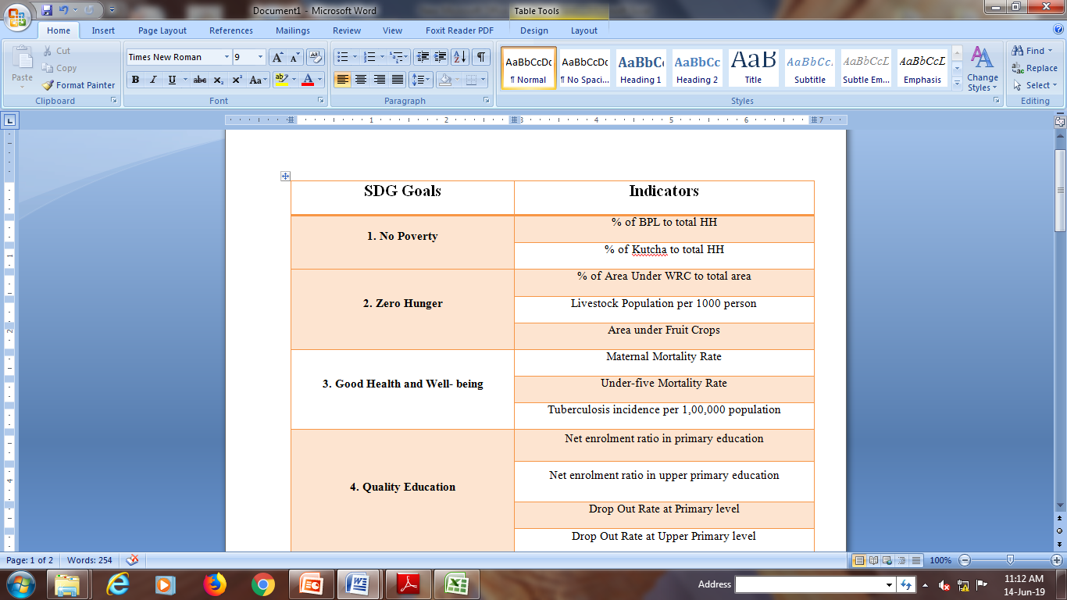

Slide 36
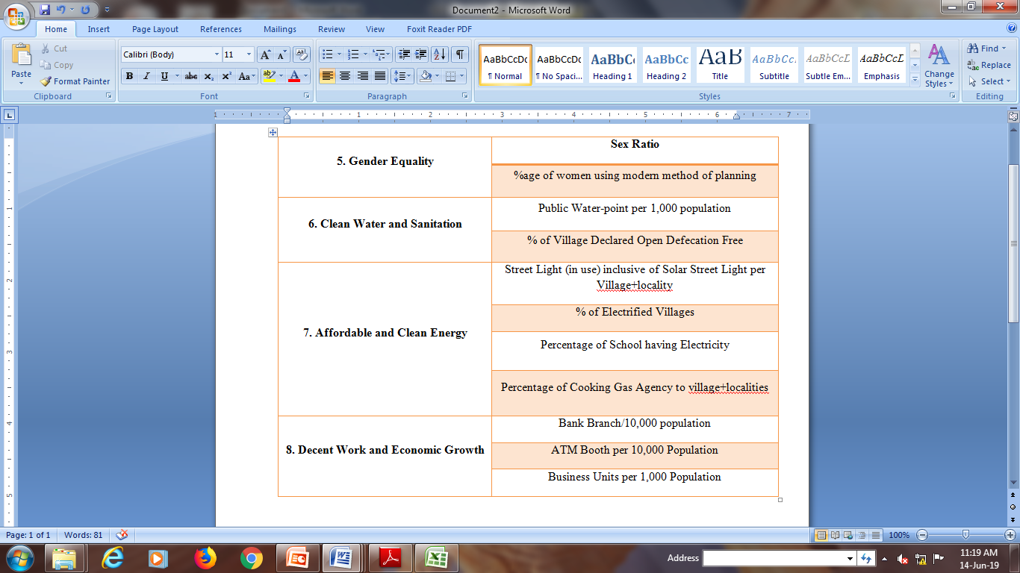

Slide 37
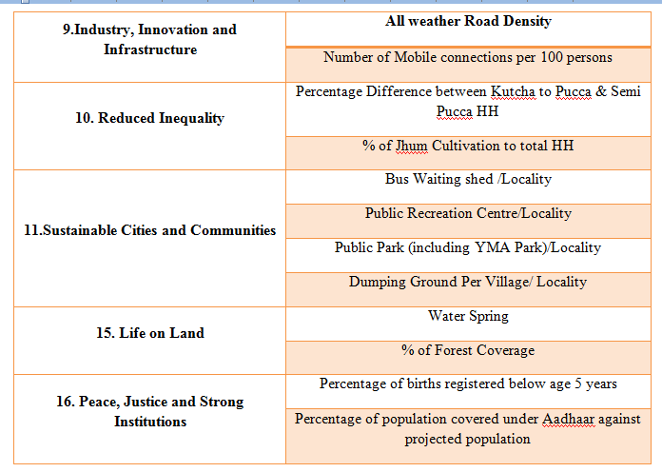

Slide 38
District-wise Performance on SDGs
Rank | Name of Districts | Index Score
1 | Aizawl | 63
2 | Kolasib | 62.5
3 | Serchhip | 61.9
4 | Champhai | 54.6
5 | Lunglei | 46.3
6 | Mamit | 46
7 | Siaha | 44.2
8 | Lawngtlai | 42.6

Slide 39
THANK YOU

